Slide 1
Autonomous 2D Map Making Robot
Group Members: Sashank Bandemegala, Nicholas DiPaolo, Aaron Chiu, Luwan Wang, Adam O’Reilly, Chantel Lepage

Slide 2
Overview
A robot that has the ability to make a map of its surroundings autonomously when put in a room or a maze
2 Main Processes
Autonomous Driving
On-board microcontroller gathers sensor data to determine the robot’s next movement through 1 Ultrasonic sensor
2D Mapping
Uses a bluetooth module along with the microcontrollers data to send information back to the main computer for further processing
Uses MATLAB to create a map of the robots surroundings in real time
Uses information from all 4 Ultrasonic sensors

Slide 3
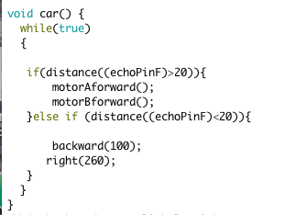

What We’ve Done So Far
Autonomous Driving
The information received from the sensor is being used by the programmed Arduino Nano in order to determine the robots next movement
Logic:

Slide 4
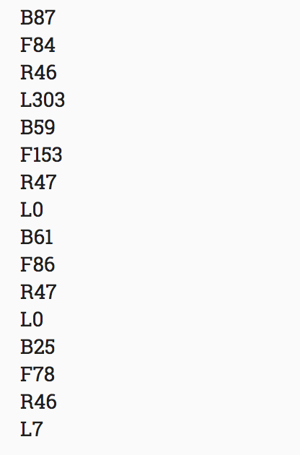
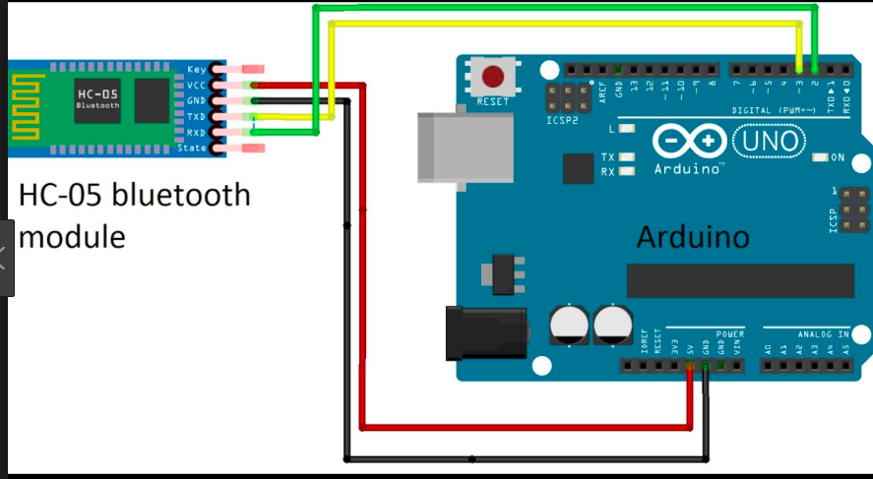
What We’ve Done So Far
Bluetooth Module
The information received from the sensor is sent to the main computer in order to create a map of the robots surroundings
Using information from sensors, the data has been uploaded onto matlab
Circuit: Output:

Slide 5
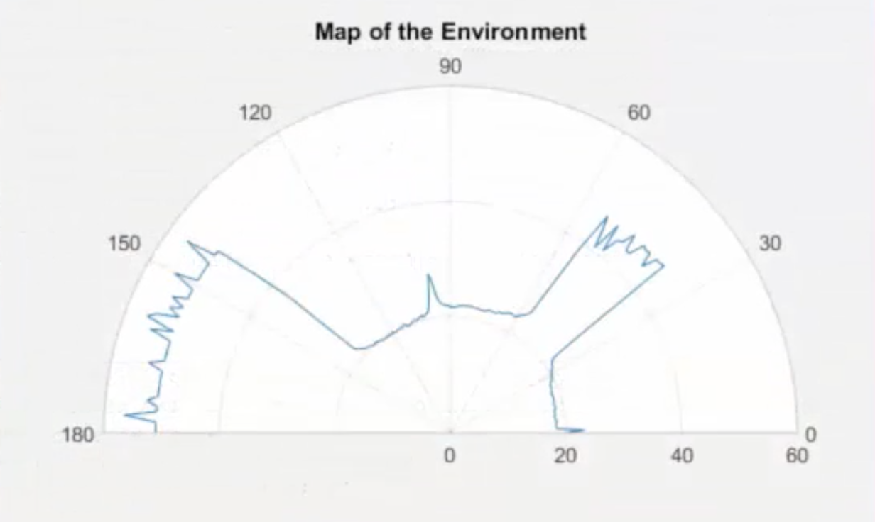
What Needs To Be Done
Plotting the map in matlab by using the transmitted data from bluetooth module
Checking for errors such as anglement of the sensors
Expected Real-Time view

Slide 6
Problems We Faced
Time:
The time was not sufficient enough to also implement the on-board live camera feed as expected
Mapping:
Wi-Fi module didn’t work, changed to use bluetooth module
Need to find a way to store the values received from the bluetooth module
Power:
Didn’t have enough power for all sensors to work together (fixed by adding voltage regulator)
Batteries die out really quick, the

Slide 7
References
[1]"Bluetooth module hc-05 with Arduino", YouTube, 2018. [Online]. Available: https://www.youtube.com/watch?v=DLwzwXC3N2Q. [Accessed: 02- Apr- 2018].

